Slide 1

V⁷
MUS 213 – October 2, 2017

Slide 2
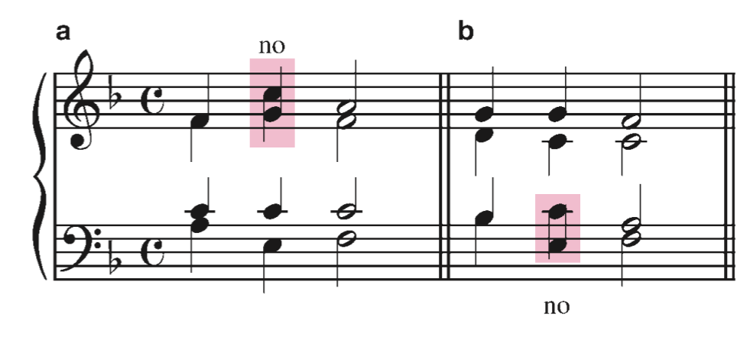
Part-writing Guidelines
We are going to do a quick review of Part Writing guidelines.
Avoid Crossed Voices.
This is where a voice is higher than the voice part above it, or lower than the voice part below it.

Slide 3
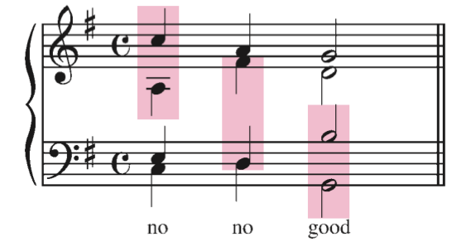
Part-writing Guidelines
Voice Spacing
Avoid overly spacious chord voicings
There should be no more than an octave between each voice, excluding between the tenor and bass.

Slide 4
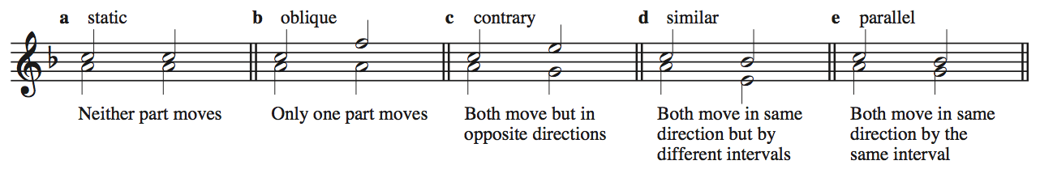
Parallel Motion
In tonal music, it is important to consider the relationships between any voice in the texture and every other voice in the texture.
When music progresses from one chord to the next, there are five possible relationships between any two voices (or parts).
In a four-part texture, there are six distinct pairs of voices, that each have their own movement type for each chord change.

Slide 5
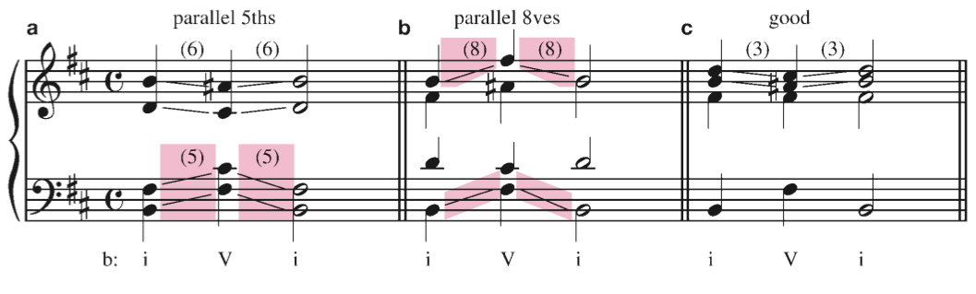
Objectionable Parallel Movement
A hallmark of this style we are learning is the independence of voices.
P5 and P8 are the most stable and pure intervals
When two voices are at an interval of a P5 or P8 and move in parallel motion the voices become linked and the independence of each voice is lost.

Slide 6

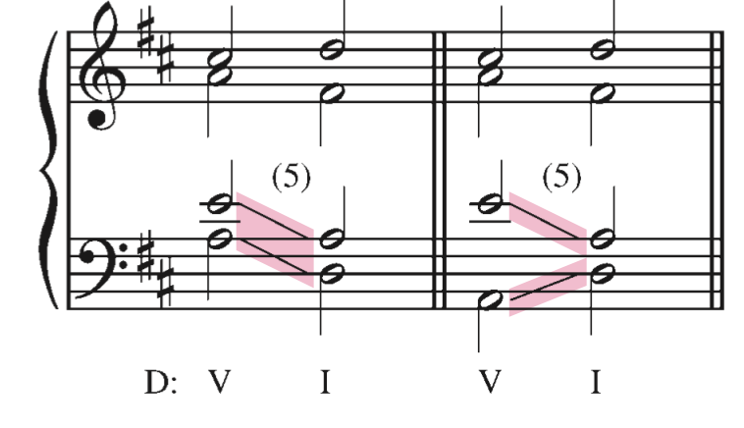
Contrary 5ths and Octaves
We also avoid contrary movement in 5ths and octaves.
These have a similar sonic effect as parallel 5ths and octaves

Slide 7
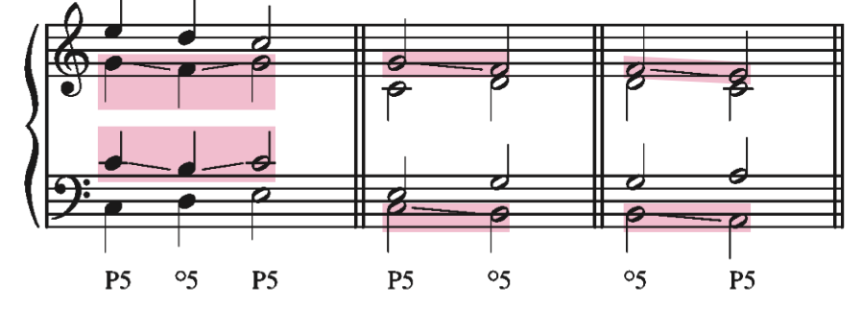
Unequal 5ths
Unequal 5ths are parallel 5ths where one of the fifths is diminished.
º5 → P5
P5 → º5
These are generally considered acceptable, unless the unequal fifth involves the bass voice and is moving from º5 → P5
Just avoid them

Slide 8
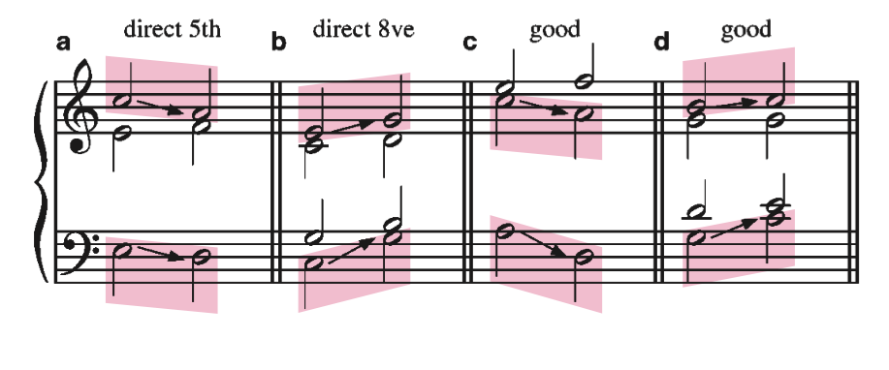
Direct Fifths and Octaves
A direct fifth or octave results when the outer voices move in the same direction and arrive on a perfect fifth or octave. The soprano part must be leaping.
This sounds very close to parallel fifths and octaves, so we avoid them.
Essentially, our ear fills in the notes that the soprano leaps over, and this creates the illusion of parallel motion.

Slide 9
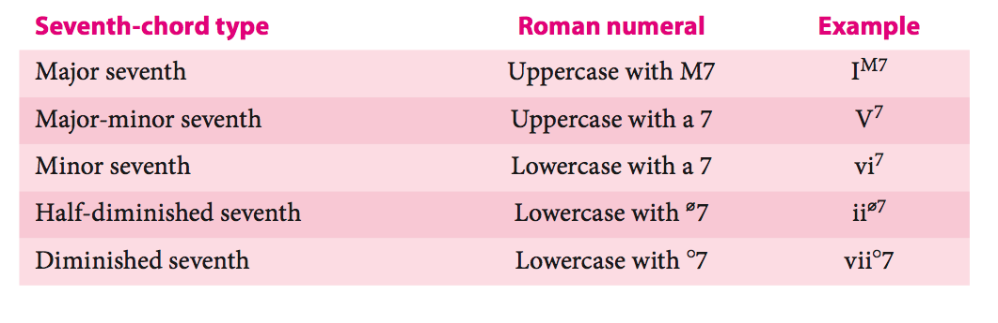
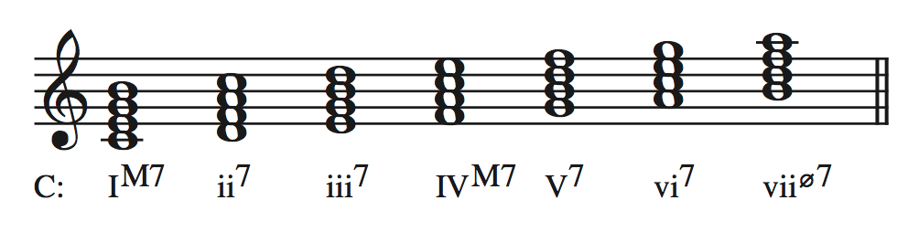
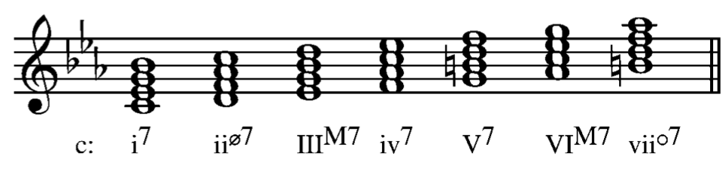
Diatonic Seventh Chords
We have already seen and analyzed many diatonic seventh chords this semester.
MAJOR
minor
Notes:
We have already seen a bunch of 7th chords, now we will look closley at how composers use them in tonal music. We will look at common and proper ways to handle the dissonance in the seveth chords.

Slide 10
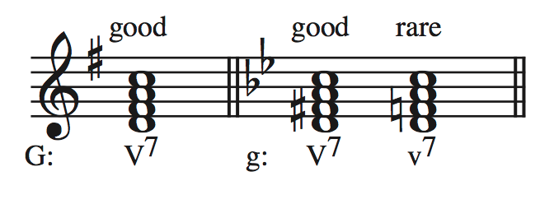
Dominant Seventh
The diatonic seventh chord most commonly encountered is a major-minor seventh chord.
It only diatonically occurs on the fifth scale degree, or dominant of a key.
It is so common that the term ”Dominant Seventh” and “Major-minor seventh” are used interchangeably.
In a minor key it is necessary to raise scale degree 7.
The minor seventh chord built on scale degree 5 is rarely used.

Slide 11
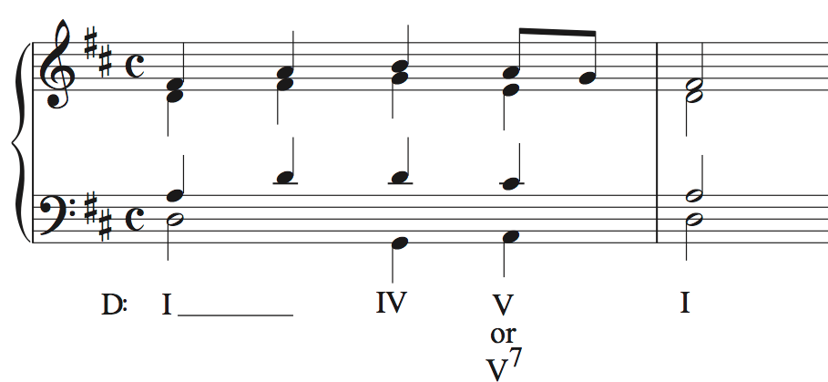
V or V⁷ ?
Often the 7th of a chord occupies only a portion of the chord’s duration
The chord may be correctly labeled either as:
a 7th chord
a triad with an NCT
It is not necessary to do both

Slide 12
V⁷ Voice Leading – resolutions
The 7th
always
resolves
down
The
leading
tone
resolves
up

Slide 13
V⁷ Voice Leading – resolutions
We can think about these two rules in several ways:
Scale Degrees of the Key
4 → 3
7 → 1
Chord members
7th of the dominant chord → 3rd of the tonic chord
3rd of the dominant chord → root of the tonic chord
IMPORTANT – Do not confuse:
7th of the Dominant chord
with the
7th scale degree of the key
i.e. the leading tone
i.e. the third of the dominant chord

Slide 14
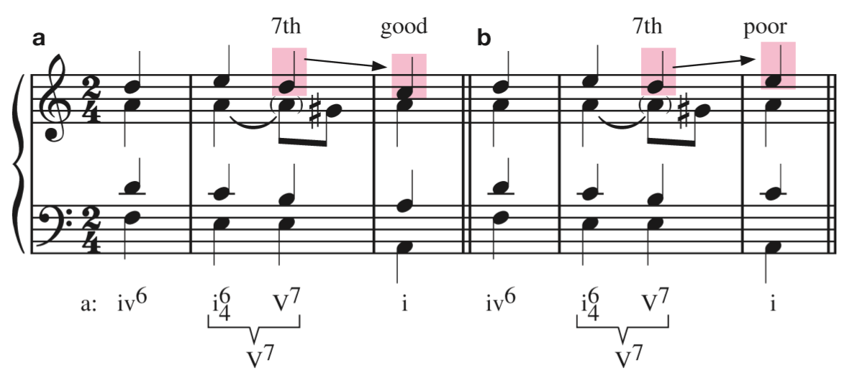
V⁷ Voice Leading – resolutions

Slide 15
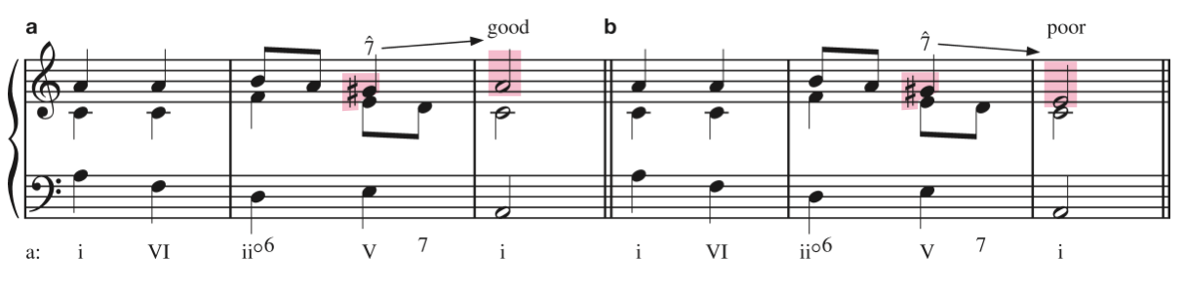
V⁷ Voice Leading – resolutions

Slide 16
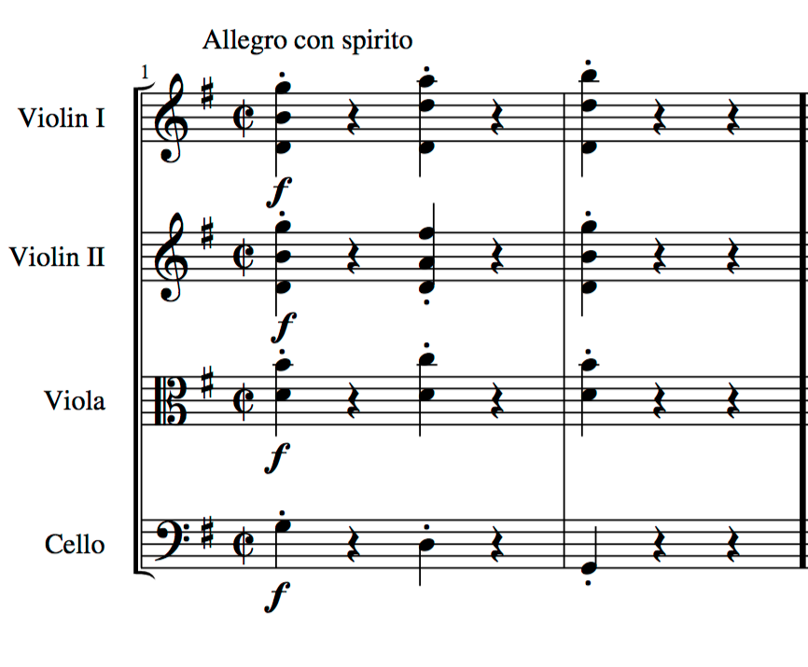

Haydn: String Quartet in G Major, op. 76 no. 1, mvt. 1

Slide 17
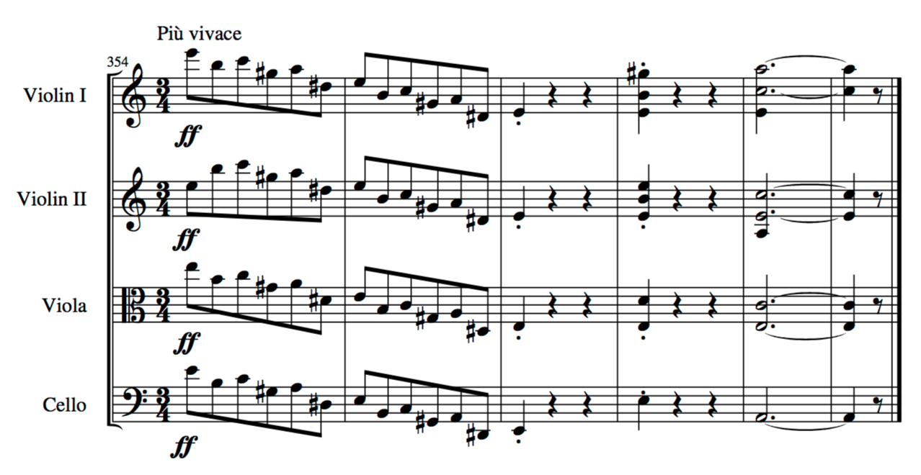
Brahms, String Quartet no. 2 in a minor, op. 51 no. 2

Slide 18
V⁷ Voice Leading – resolutions
The resolution of a root position dominant 7th to a root position tonic chord can get a little tricky.
Let’s start with what we know:
The 7th (ˆ4) must resolve down by step to ˆ3.
The 3rd of the chord (ˆ7), when in the top part, must resolve up by step to ˆ1
What is the interval between the 3rd and 7th of a dominant seventh chord?
Tritone
Which can be spelled as either an:
+4
º5
Notice that the +4 always resolves to a m6, and that the º5 always resolves to a M3.

Slide 19
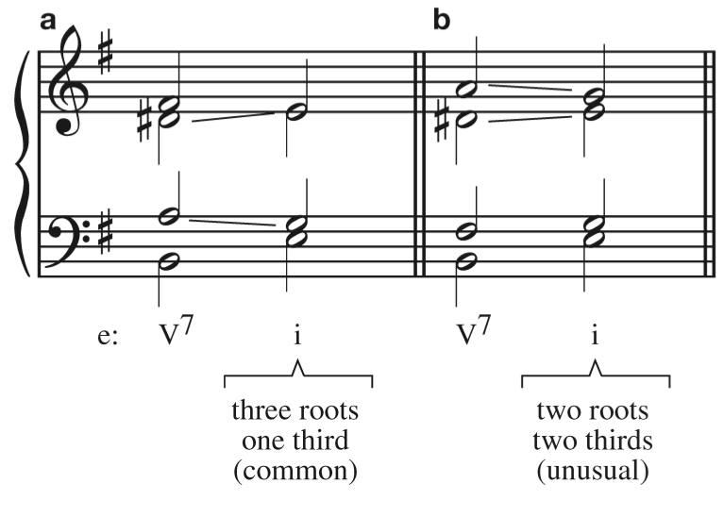
V⁷ Voice Leading – resolutions
You will notice that when we follow these two rules in a 4-part texture we resolve to an incomplete tonic triad.
This is acceptable, and quite common in tonal music.

Slide 20
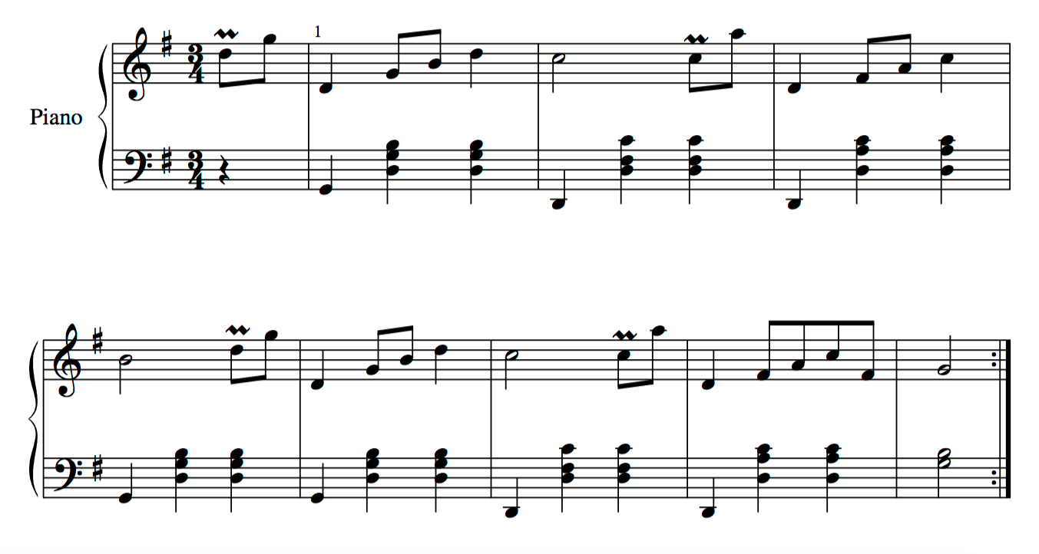
Schubert, Originaltänze, D. 365 no. 19

Slide 21
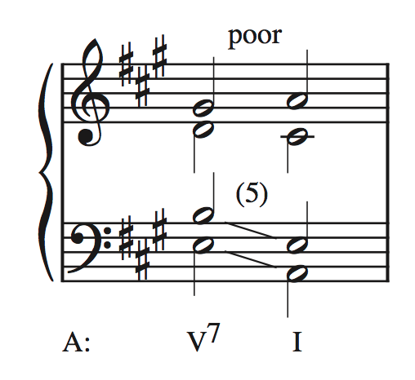
V⁷ Voice Leading – resolutions
What about resolving to a complete tonic triad???

Slide 22
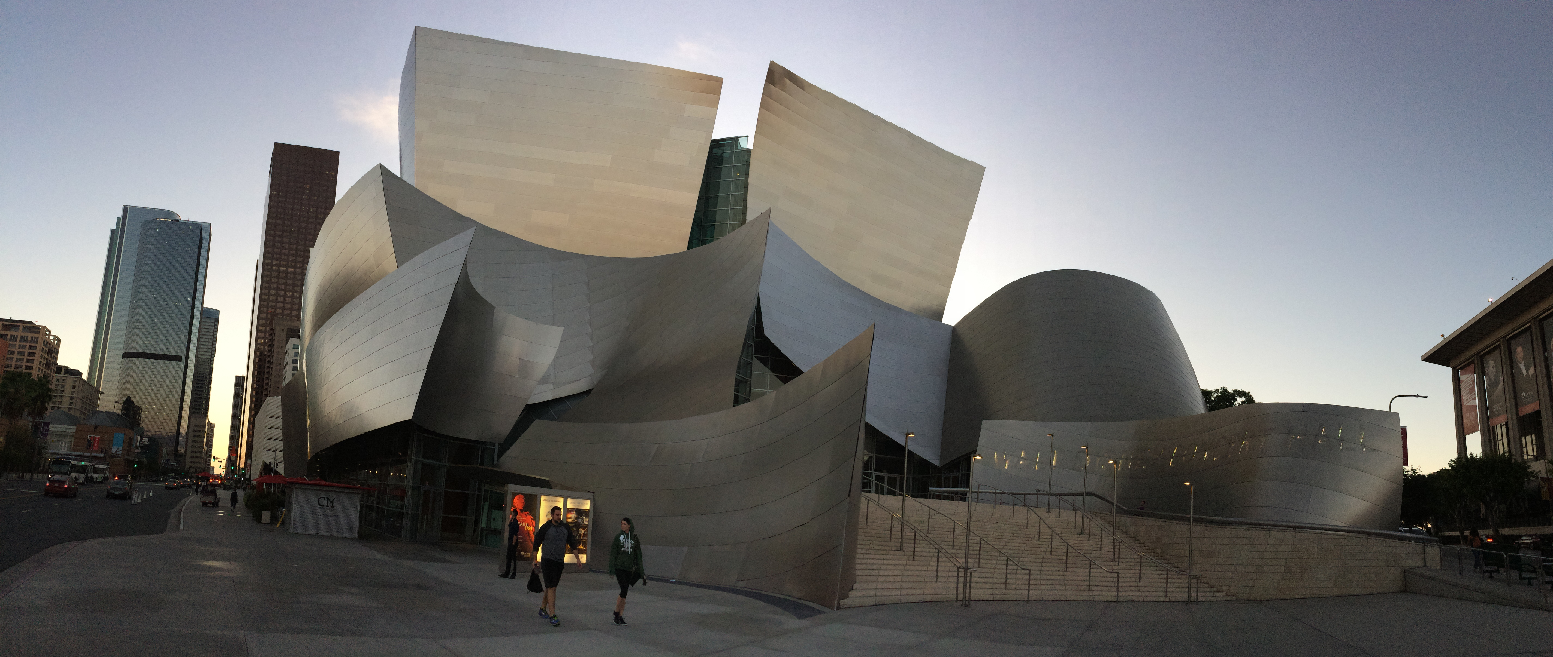

Slide 23
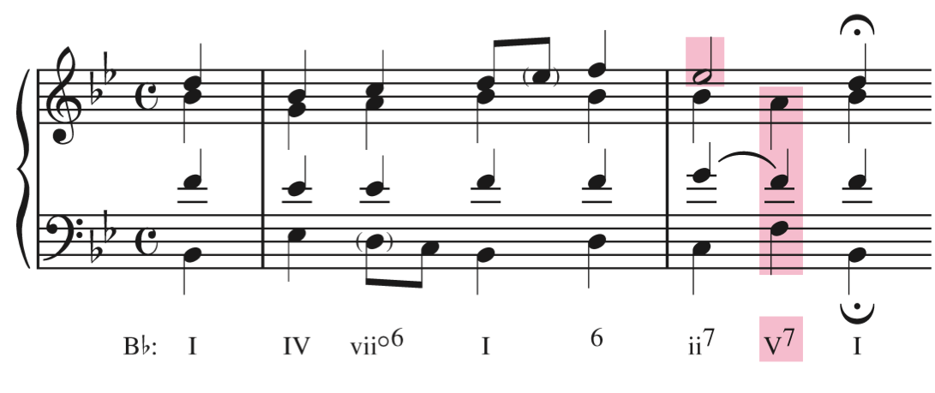
V⁷ Voice Leading – resolutions
We have two options to avoid a parallel 5th and resolve to a complete tonic triad:
Use an incomplete V⁷, omitting the 5th and doubling the root.

Slide 24
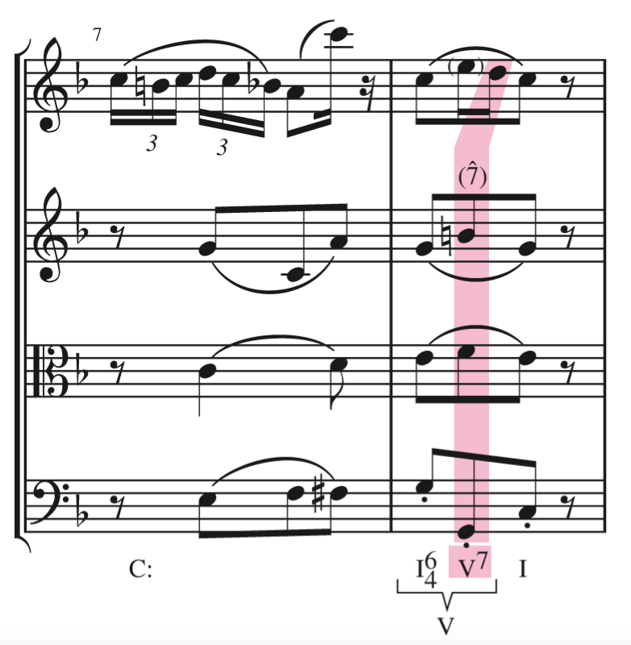
V⁷ Voice Leading – resolutions
2. Use a complete V⁷, but put the leading tone (3rd of the V⁷) in an inner part and “frustrate” its natural resolution by taking it down a M3 to the 5th of the tonic triad.

Slide 25
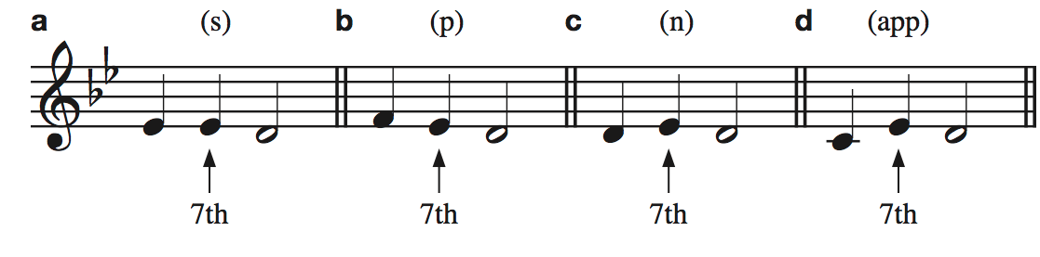
V⁷ Voice Leading – approaches
We classify the approach the the 7th of the dominant chord in a similar fashion to NCTs
Suspension figure: the same pitch class as the 7th
Passing tone figure: a step above the 7th
Neighboring tone figure: a step below the 7th
Appoggiatura figure: a leap into the 7th.
The App. Figure is rare, if used make sure to use an ascending leap.

Slide 26
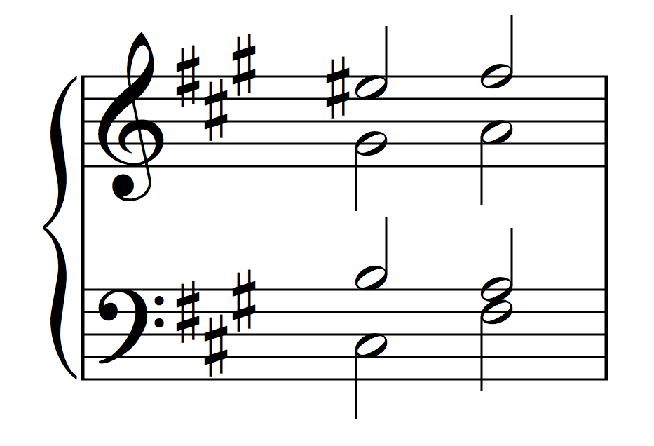
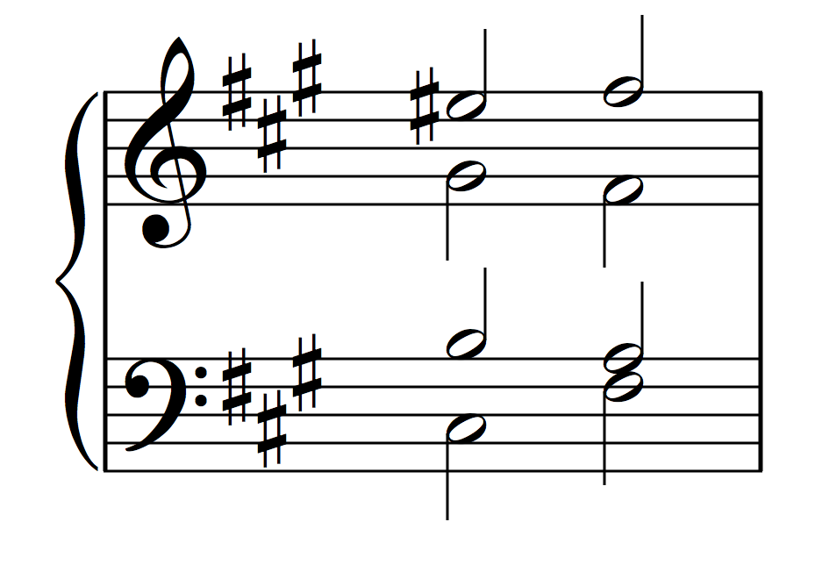
V⁷ Review
Complete → Incomplete
Leading tone resolves up
5th resolves to the 3rd
Doubling the 3rd
5th resolves to tonic
Tripling the root
7th resolves down
Root position
chords
f#: V⁷ i

Slide 27
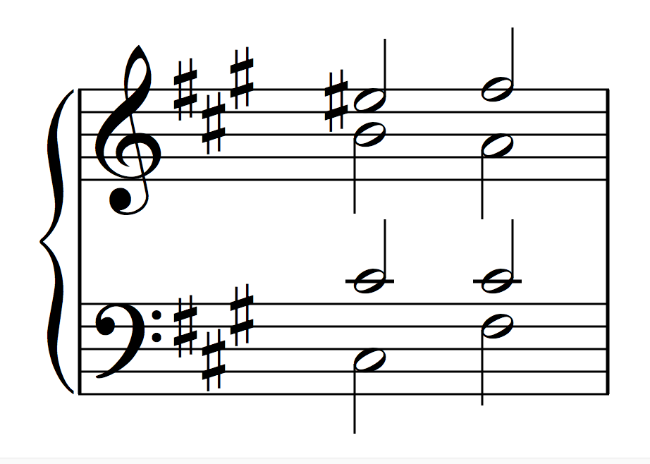
V⁷ Review
Incomplete → Complete
Leading tone resolves up
7th resolves down
Doubled Root becomes 5th
Doubling the root
Root position
chords
f#: V⁷ i

Slide 28
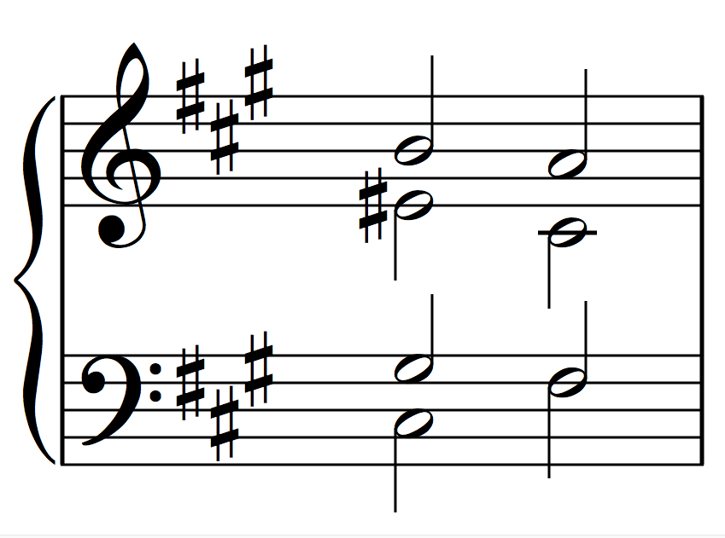
V⁷ Review
Complete → Complete
7th resolves down
Leading tone frustrates to
resolve down a M3
5th resolves to tonic*
Doubling
the root
Root position
chords
* Can also resolve to 3rd, which would result in a doubling of the 3rd of the tonic chord
f#: V⁷ i

Slide 29
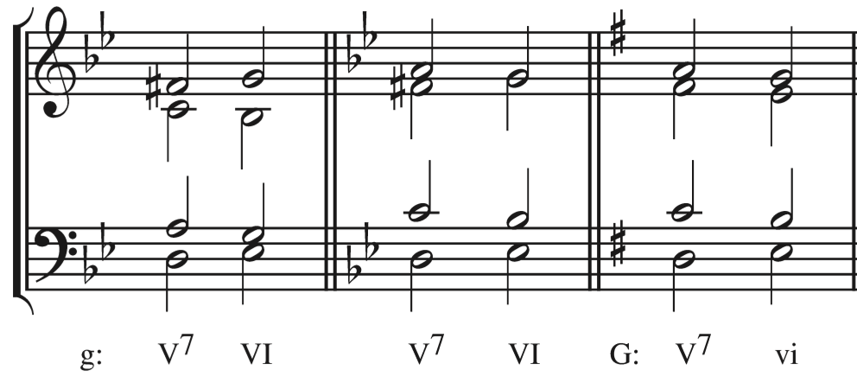
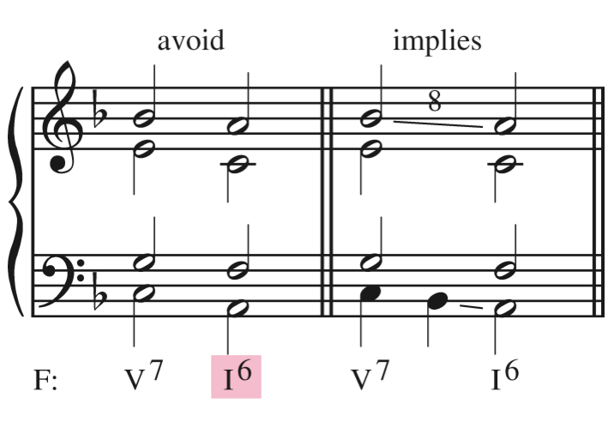
V⁷ in Deceptive Cadences
We can apply these same rules to resolving a V⁷ to a vi (or VI)
The bass(root) moves up by step to ˆ6, the root of the vi ( or VI) chord.
The leading tone (ˆ7) resolves up by step to tonic (ˆ1).
Exception: If the leading tone is in an inner voice in the major mode, it may move down by step to ˆ6
The other voices move down by step.
Don’t write a V⁷ – I₆ progression.

Slide 30
V⁷ in Inversion
It is much easier to handle the resolution of a V⁷ in inversion
However, we should not consider inverted V⁷ chords for important cadences.
Why?
Inverting the V⁷ chord lessens the harmonic pull to the tonic.
Our 2 main rules still apply:
Otherwise resolve by step
ˆ5 → ˆ5
ˆ2 → ˆ1
Think of how the V chord in a
Similar inversion functions
(passing six-four chords, etc.)
The 7th
always
resolves
down
The
leading
tone
resolves
up

Slide 31
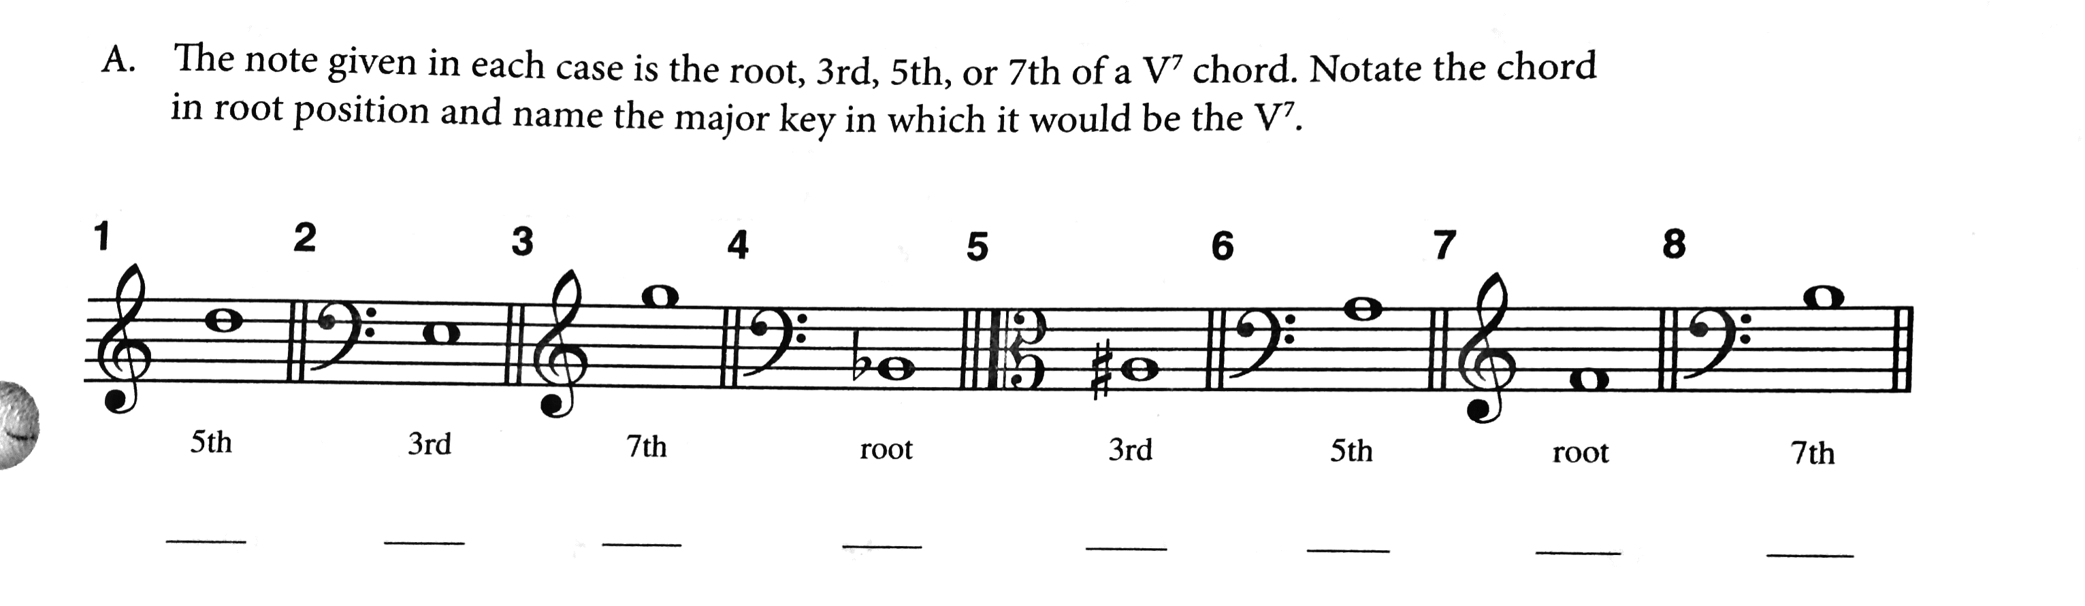

Slide 32
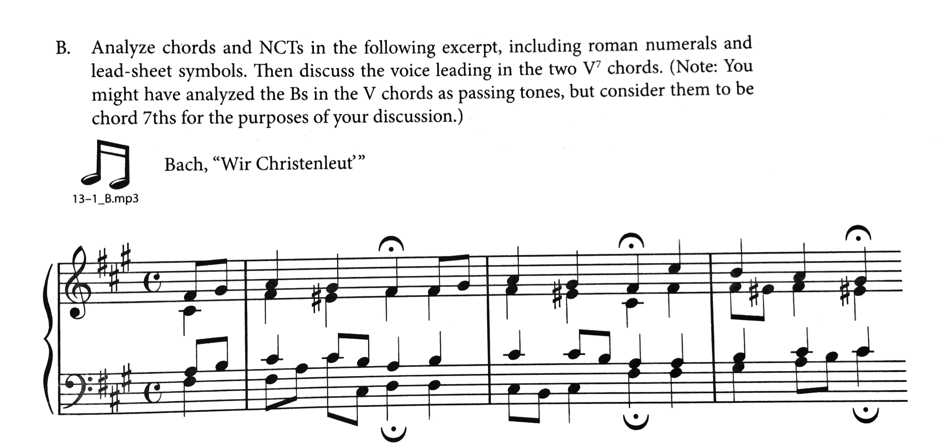

Slide 33
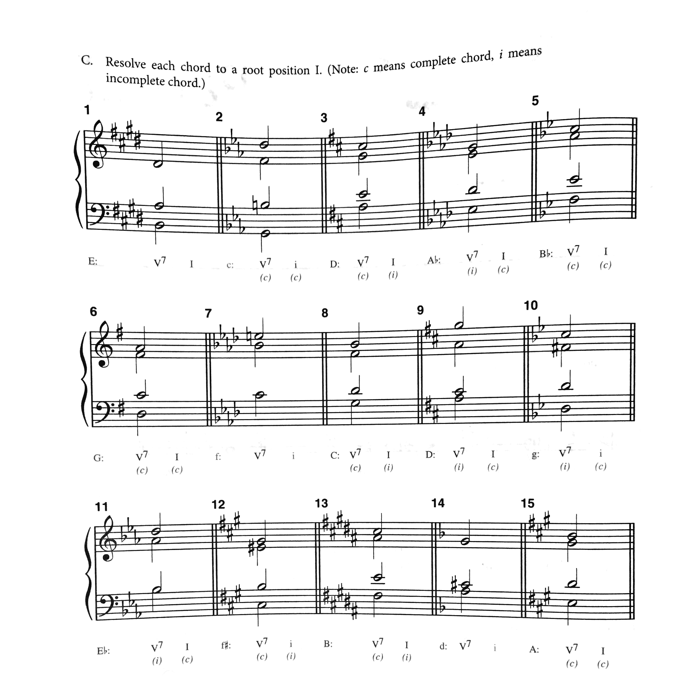

Slide 34
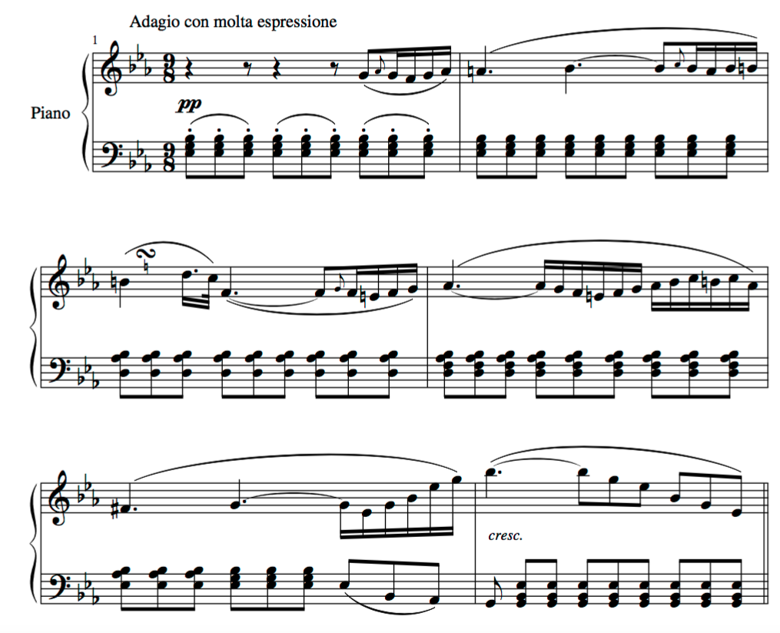
Beethoven, Piano Sonata in B-flat Major, op. 22, mvt. 2

Slide 35
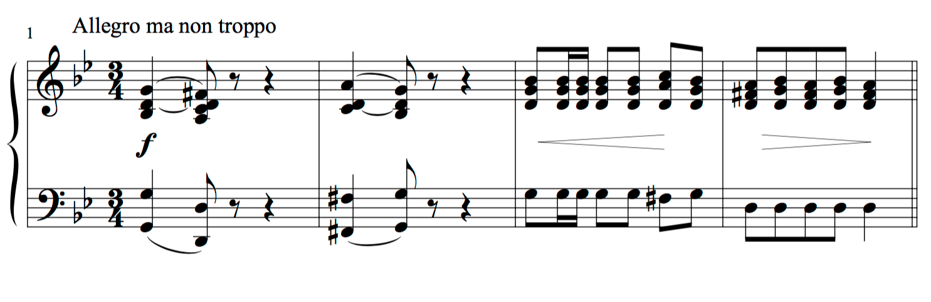
Chopin, Polonaise in g minor

Slide 36
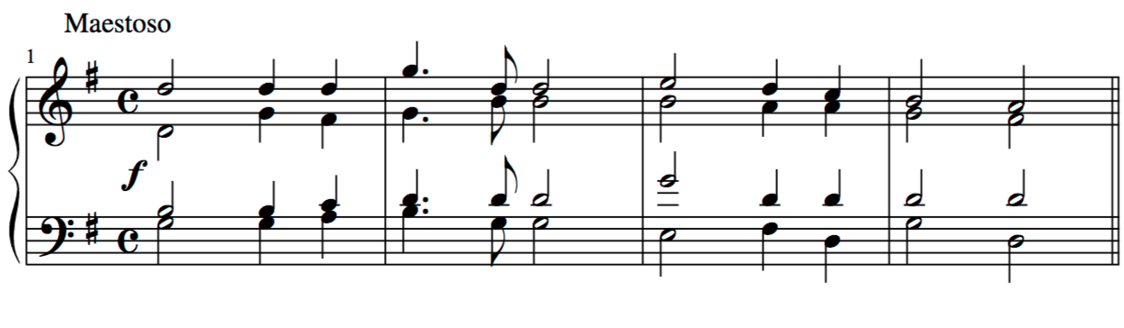
Saint-Saëns, Oratorio de Noël, op. 12 no. 9, Chorale

Slide 37
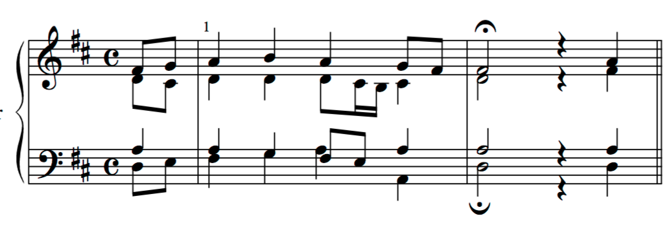
J.S. Bach, Chorale no. 60 ("Ich freue mich in dir”)

Slide 38
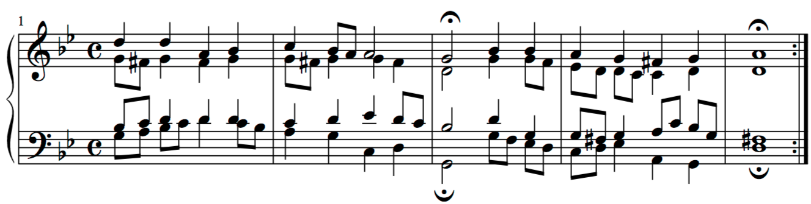
J.S. Bach, Chorale no. 269 ("Jesu, der du meine Seele")

Slide 39
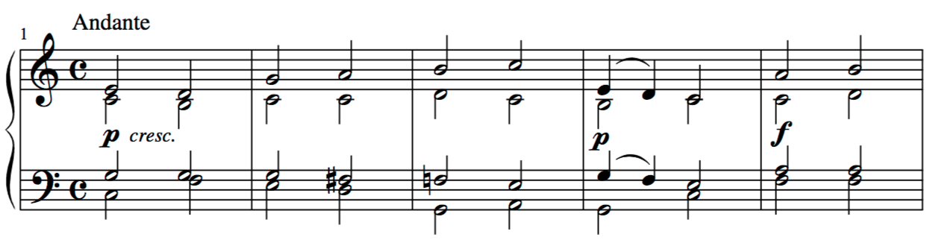
Bruckner, Tantum Ergo no. 2, mm. 1-10

